Slide 1
Data Platform Overview and Options
Subtitle or speaker name

Slide 2
Types of data platform
Local teams
Enterprise wide
Partner integration
Global teams
System related
Process related

Slide 3
Your data platform?
Write down results on paper
Manually type into Excel
Copy/paste into Word
Manually transcribe into CRM
Download as CSV
Copy into excel
Create graph
Copy/paste graph into Powerpoint for the boss

Slide 4
How can we make it happen?
What will happen?
Prescriptive Analytics
Why did it happen?
Predictive Analytics
Optimisation
Value
What happened?
Diagnostic Analytics
Descriptive Analytics
Hindsight Insight Foresight
Information
Difficulty

Slide 5



Data
010111011010101010101010101010
Recommendations
What should I do?
Decision Automation
Action
Decision Support
Predictions
What will happen?
Decision
Interactive dashboards
Why did it Happen?
Static reports
What happened?
Manual Process

Slide 6
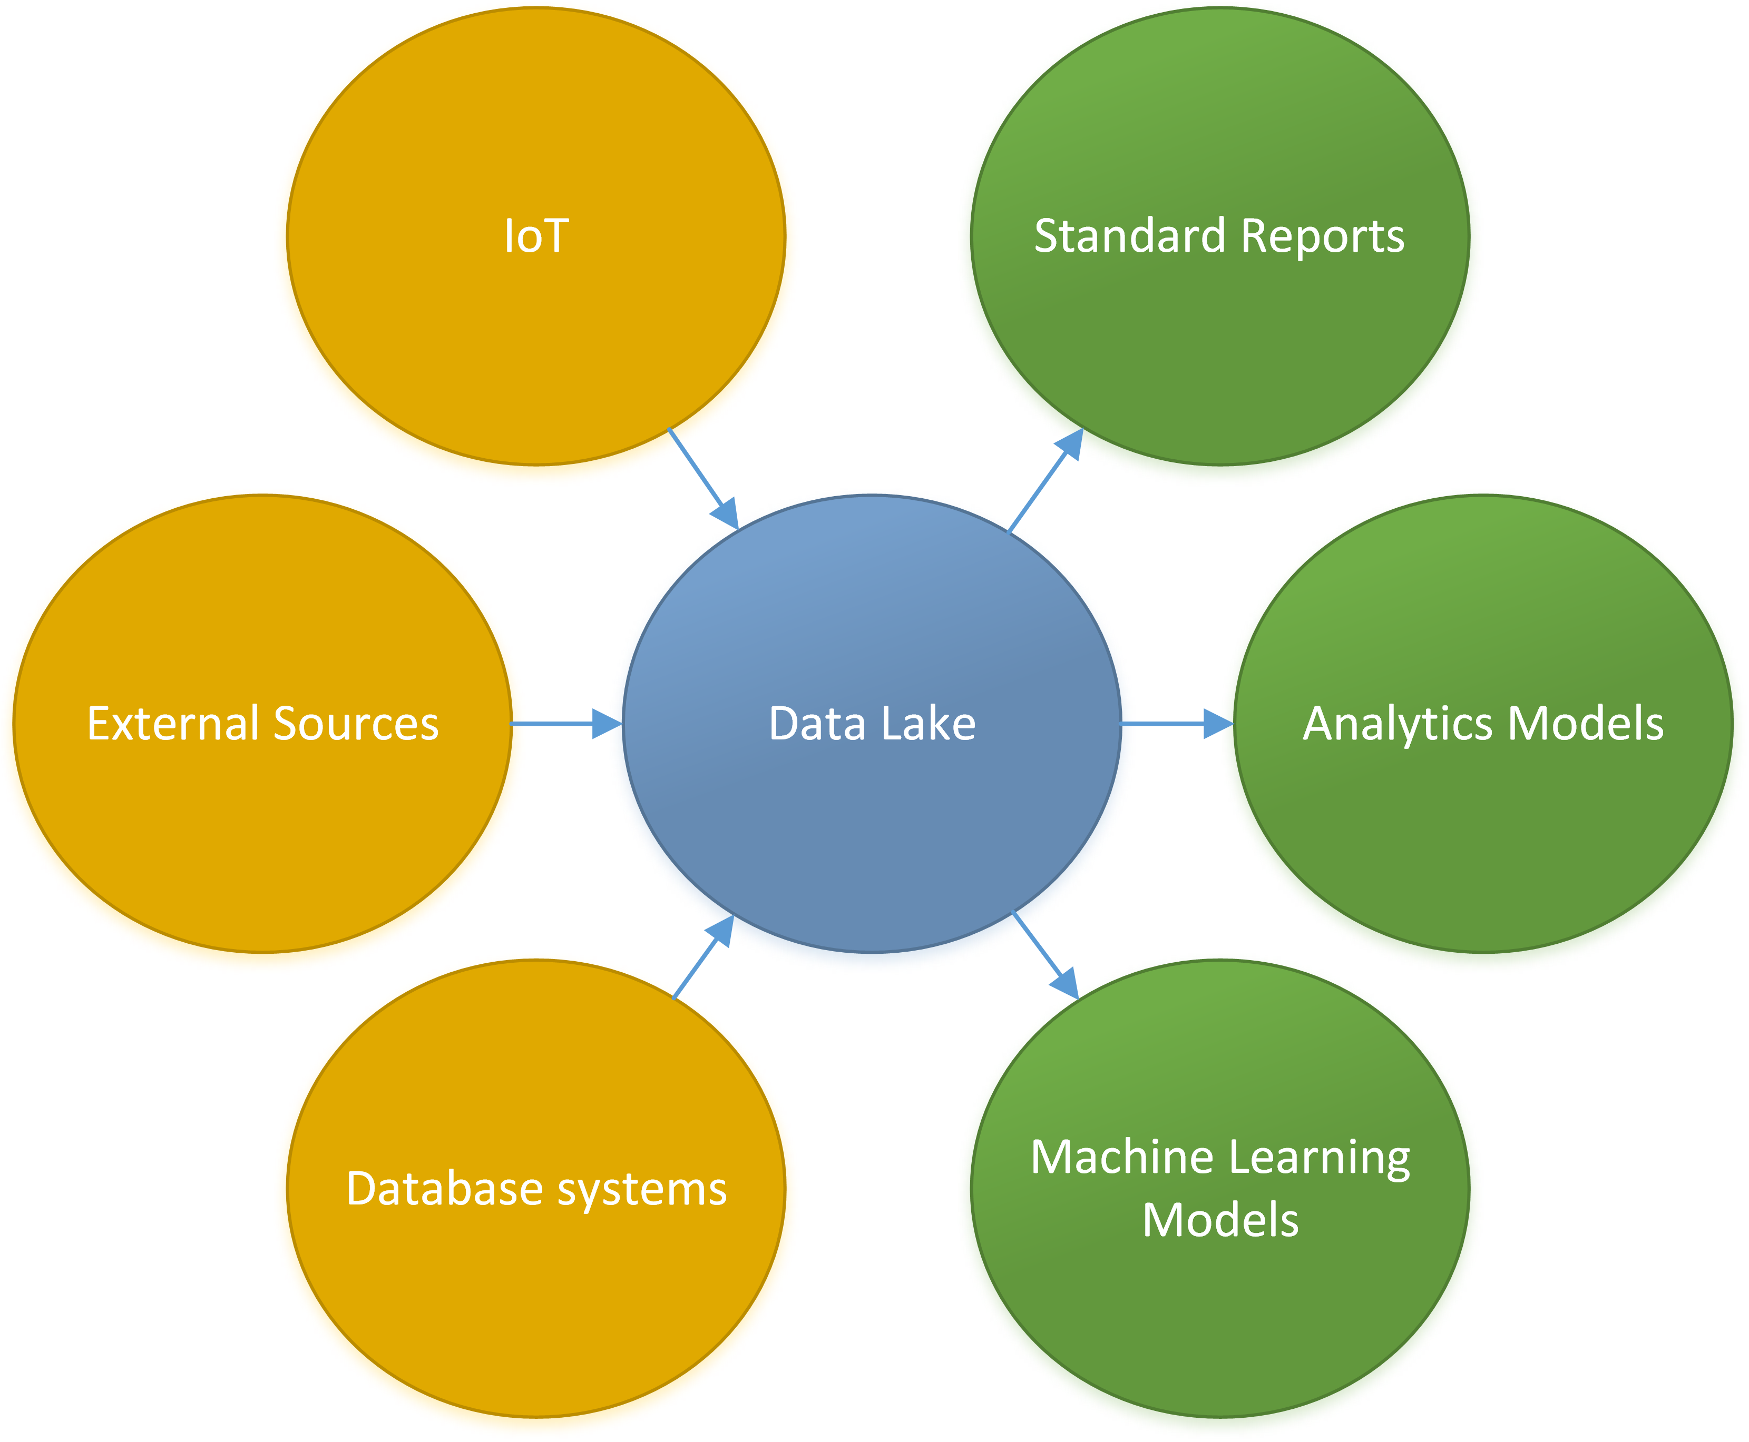

Slide 7
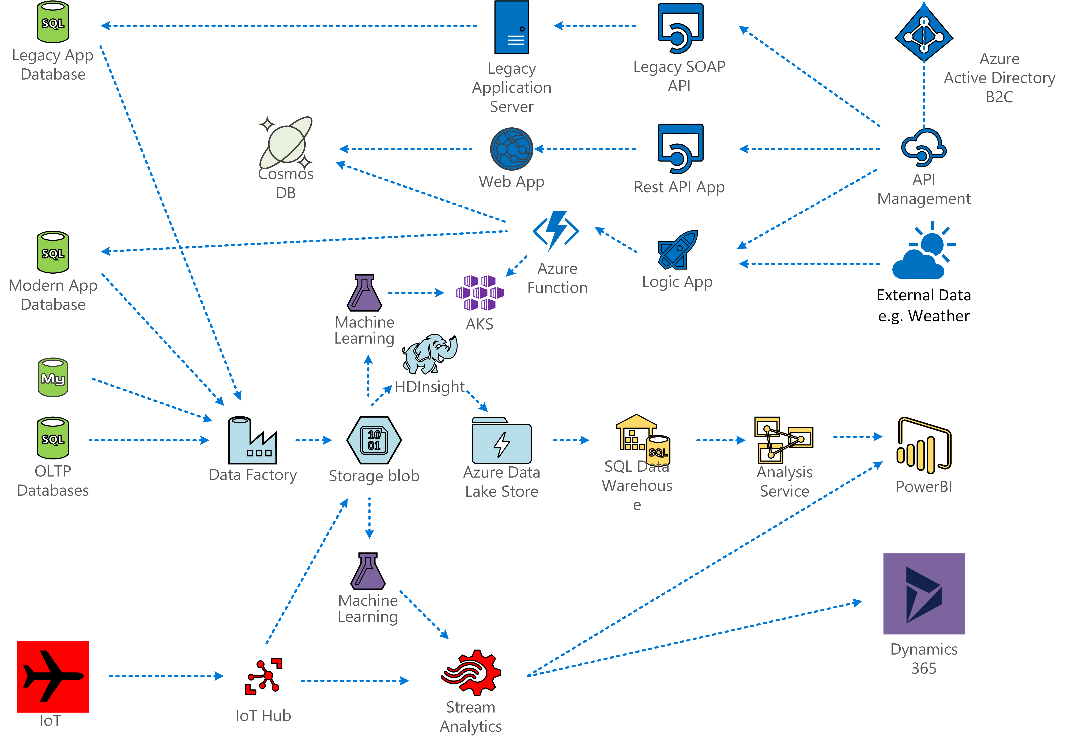

Slide 8









IoT Machines
Apps
IoT Hub
Event Hubs
Data Lake
Data Factory
Logic Apps
Databases
Weather Data

Slide 9
Data Ingest

Slide 10
Store

Slide 11
Data Preparation

Slide 12
Training ML Models

Slide 13
Data Modeling

Slide 14
Serving Layer

Slide 15
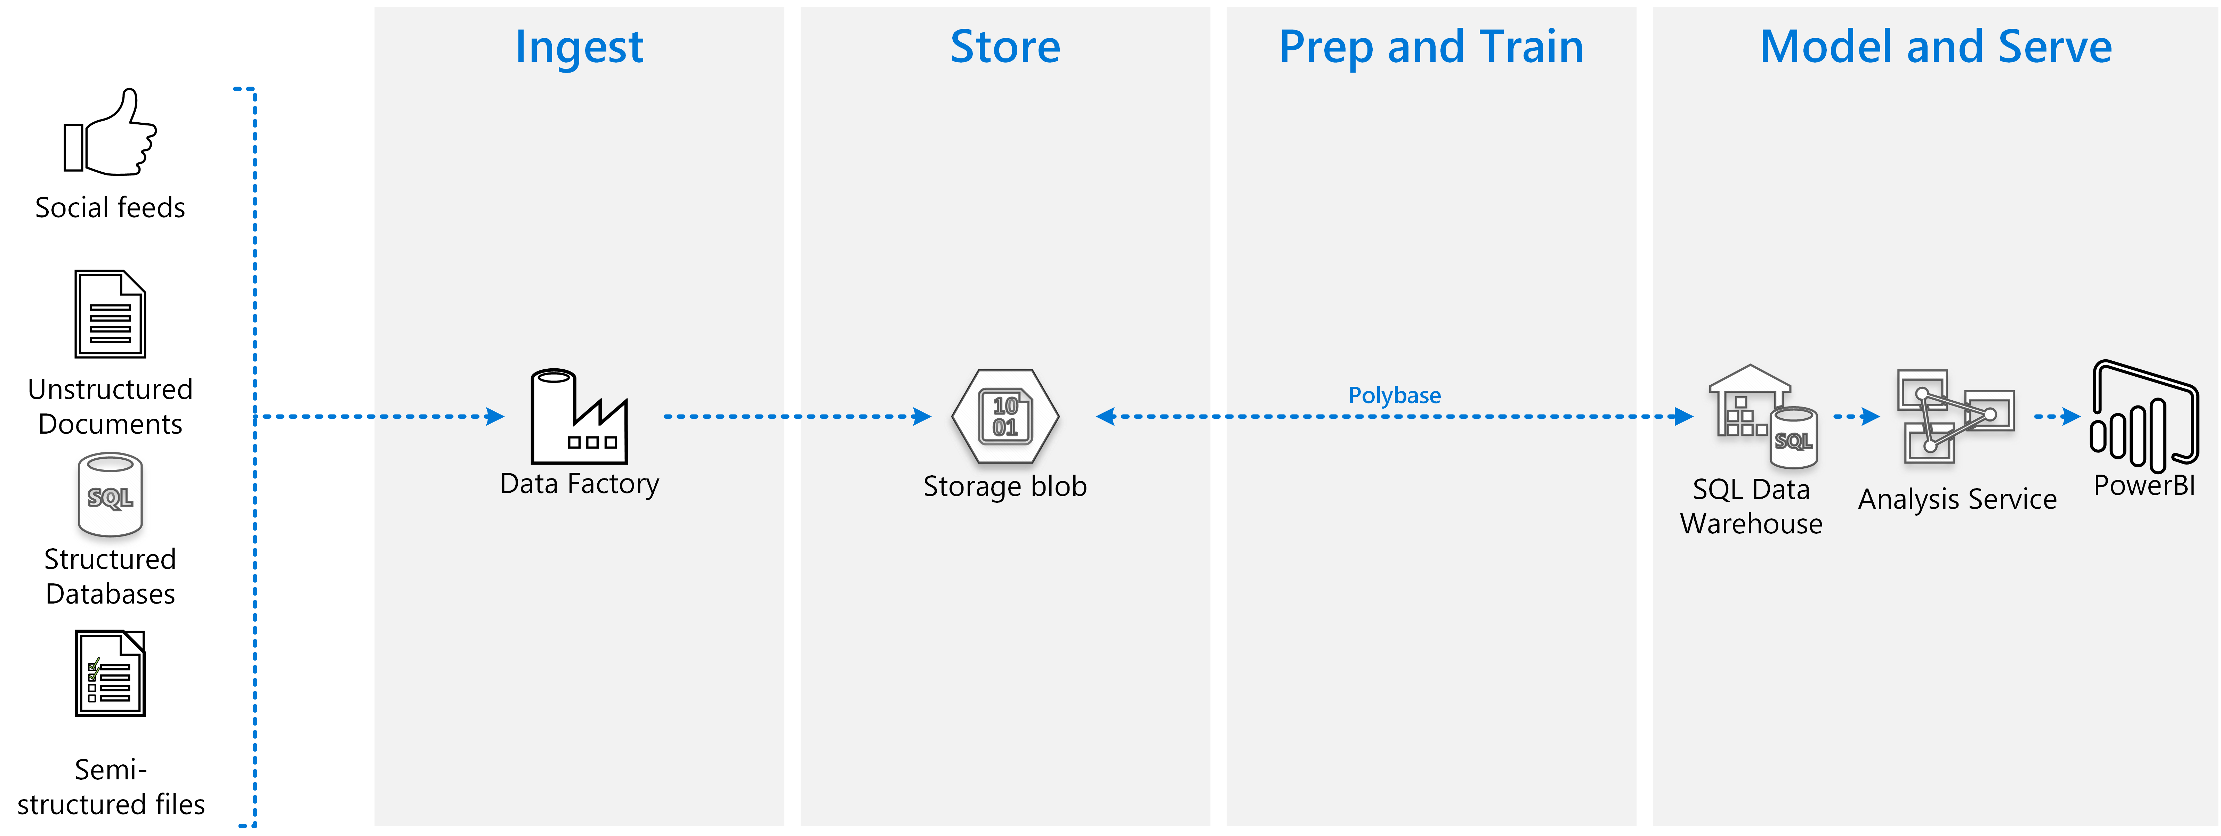
Cloud Data Warehouse

Slide 16
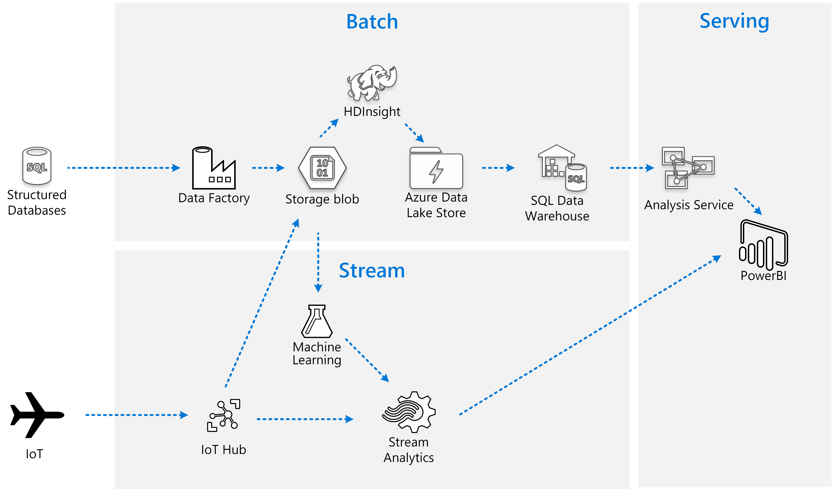
Lambda Architecture

Slide 17
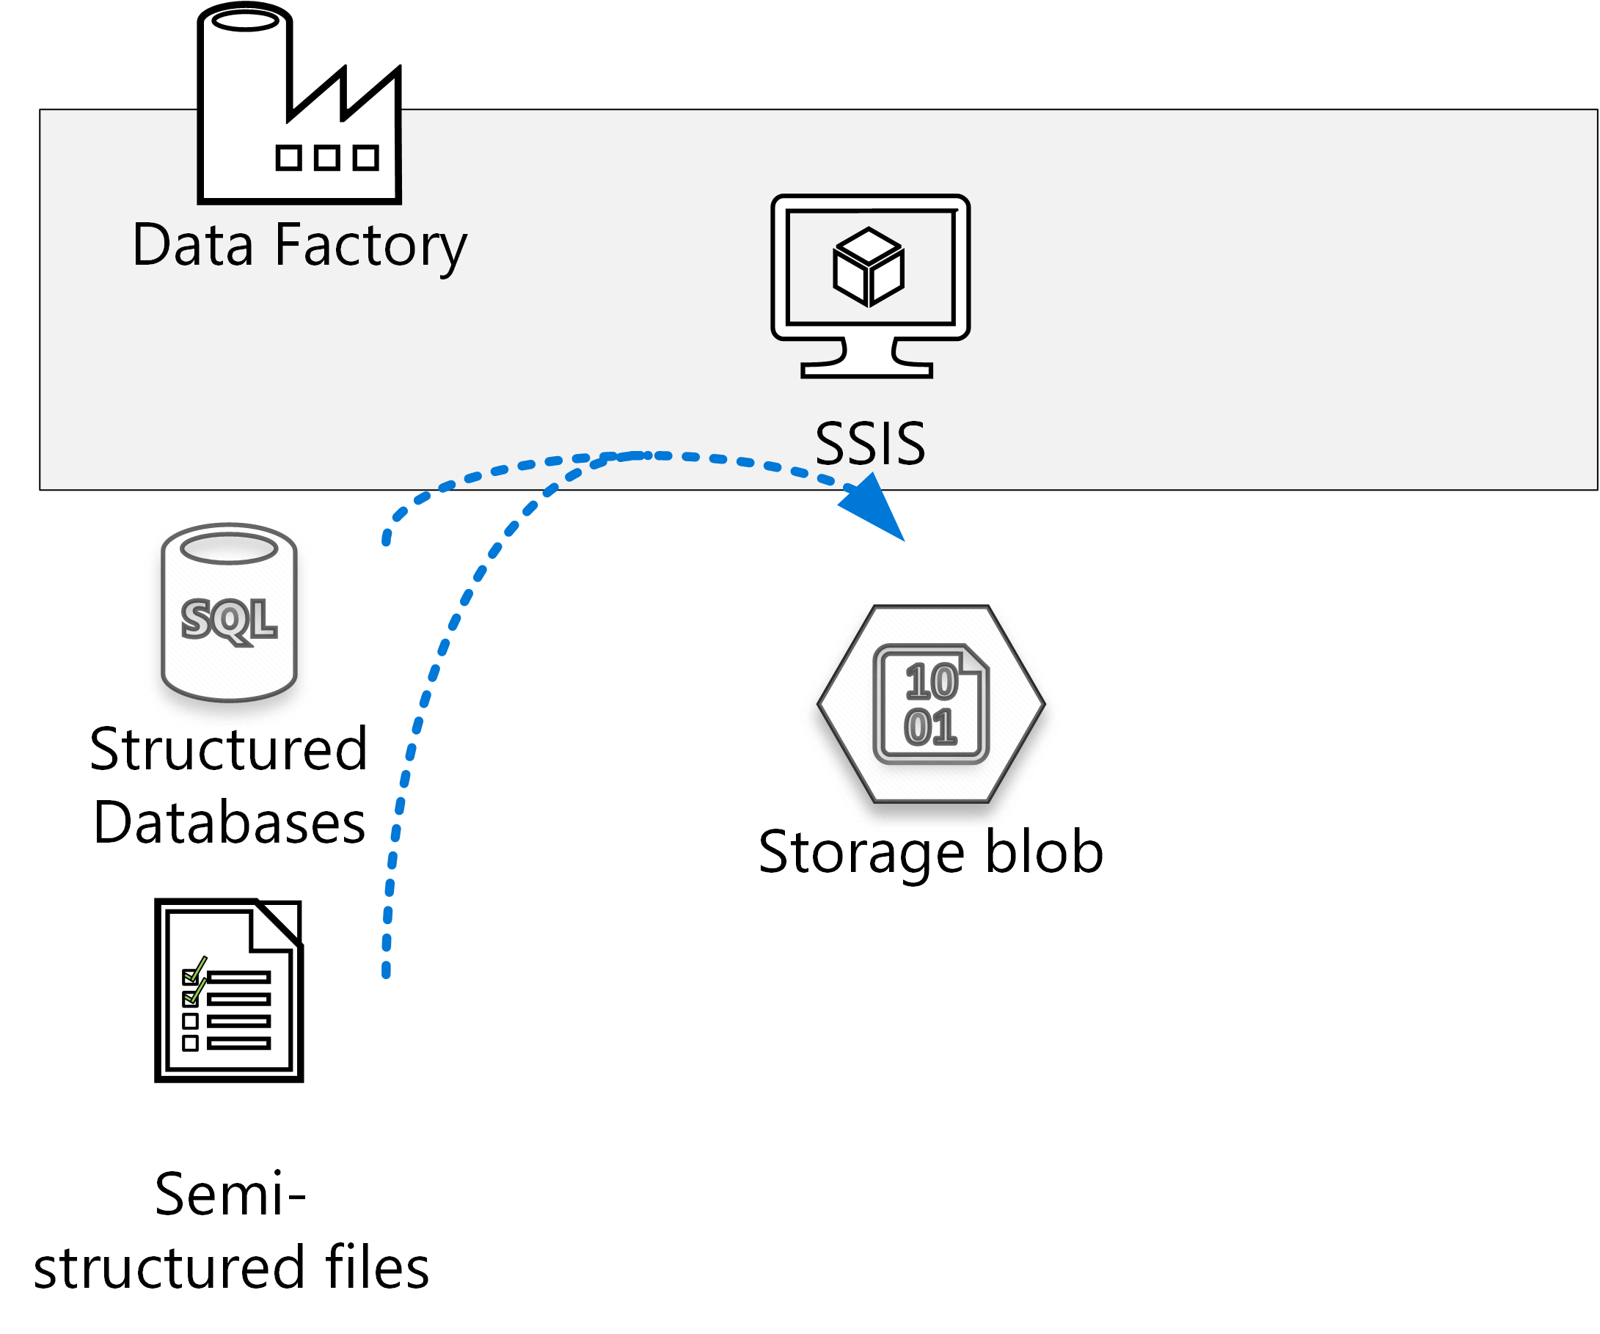
Batch Processing

Slide 18
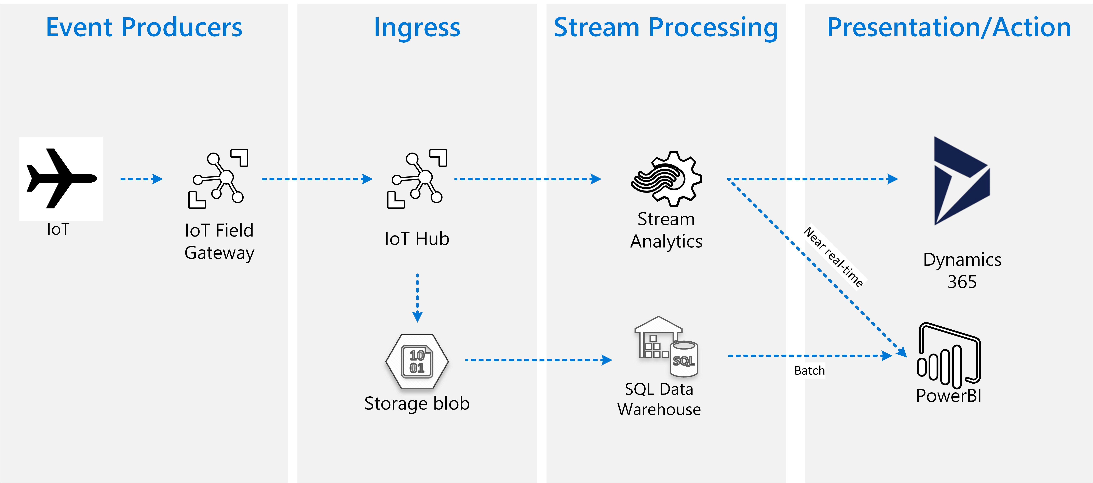
IoT Streaming

Slide 19
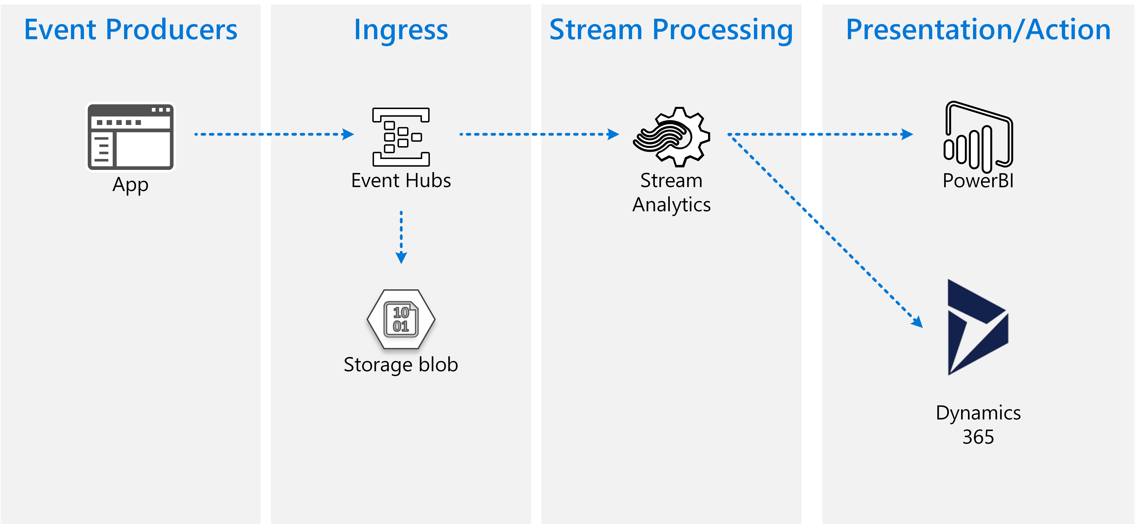
Event Hubs

Slide 20
Machine Learning

Slide 21
ML Services

Slide 22
Data Marts

Slide 23
Real Time Analytics

